Slide 1

Presentation Materials Created by Mimetics Inc.
Free use by anyone for non-commercial purposes
Copyrights, Trademarks and other Registered Marks the Property of their Owners

Slide 2
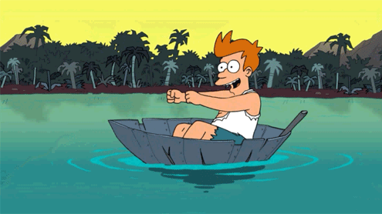
Grade 8 Systems
Class 7
Putting it All Together
Notes:
We want to introduce the Jade Robot and it’s Tools in more detail along with our action plans for it.
It’s interesting, but it’s easy to criticize something when it’s done (especially when you have experience) – a *LOT* more difficult getting it right from the start. Also, preparing this presentation was a great way to review and think about what we should be doing.

Slide 3
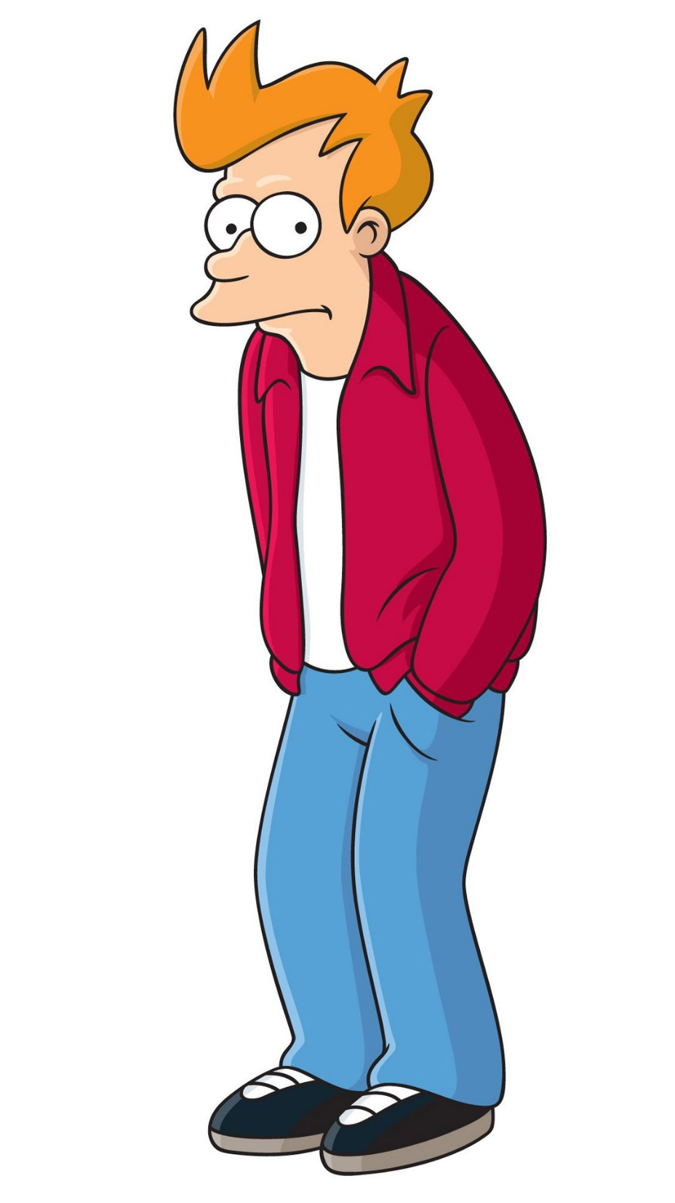
Creating a Program
Get Requirements
Break Requirements into Parts
For Each Part, List Statement Types Needed
Create a Sequence of Statements
Test Statements for Each Part
Work in Sequence and Build Up the Program as the Sum of the Parts
Test Final Program to Requirements
Celebrate!!!
Notes:
Can Demo Jade Scratch if people are interested. In doing this product I’ve had a few interesting discoveries – one was going with a simpler programming language actually has a *LOT* of value for an expert like myself.

Slide 4
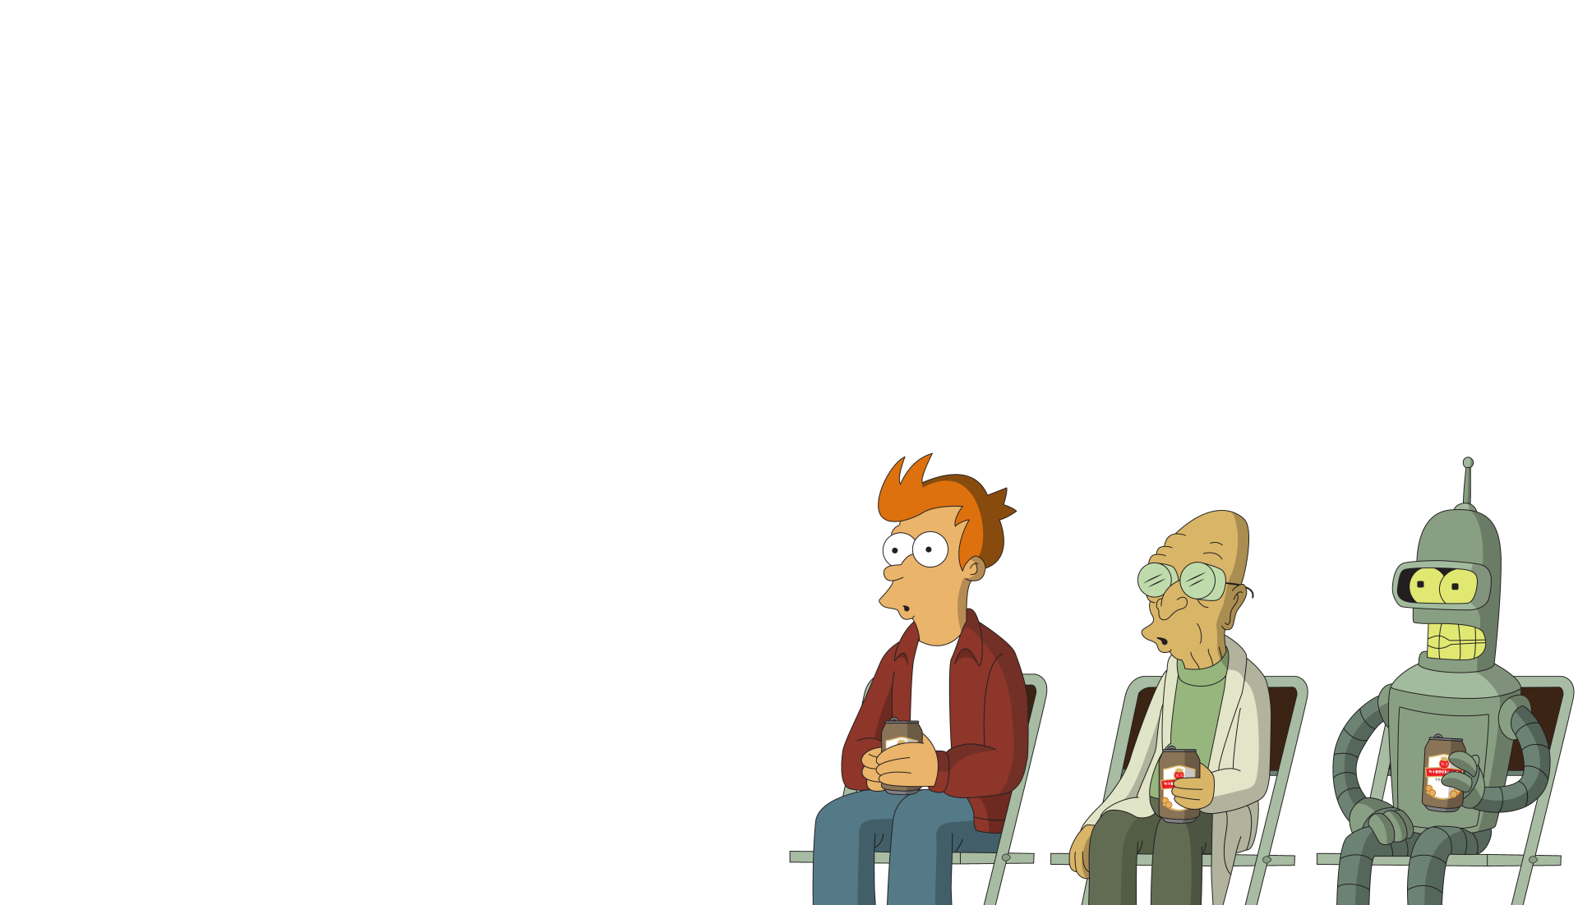
Robot Program Structure
Initialize Robot
Get Input
Process
Repeat (Loop)
Output Processed Inputs
Shutdown Robot
(Stop)
Notes:
Can Demo Jade Scratch if people are interested. In doing this product I’ve had a few interesting discoveries – one was going with a simpler programming language actually has a *LOT* of value for an expert like myself.

Slide 5
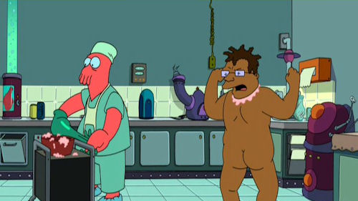
What to do when things go wrong
Notes:
Can Demo Jade Scratch if people are interested. In doing this product I’ve had a few interesting discoveries – one was going with a simpler programming language actually has a *LOT* of value for an expert like myself.

Slide 6
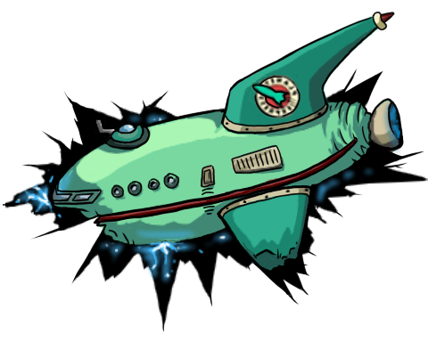
Steps to find a problem
Check Spelling/Statements
Single Step through the Program
Add Display Updates and LED Outputs to Track Progress
Isolate small Parts of the Program and Test Operation
Notes:
Can Demo Jade Scratch if people are interested. In doing this product I’ve had a few interesting discoveries – one was going with a simpler programming language actually has a *LOT* of value for an expert like myself.

Slide 7
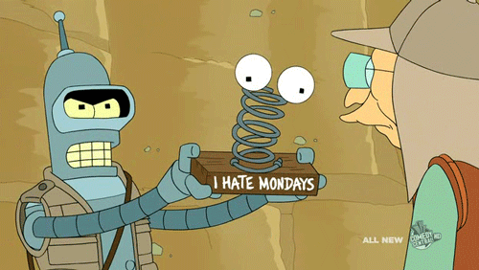
Example Program
Notes:
We want to introduce the Jade Robot and it’s Tools in more detail along with our action plans for it.
It’s interesting, but it’s easy to criticize something when it’s done (especially when you have experience) – a *LOT* more difficult getting it right from the start. Also, preparing this presentation was a great way to review and think about what we should be doing.

Slide 8

Requirements
Move Forwards Until Wall Encountered. Then Back Up to Original Position
Notes:
Can Demo Jade Scratch if people are interested. In doing this product I’ve had a few interesting discoveries – one was going with a simpler programming language actually has a *LOT* of value for an expert like myself.

Slide 9
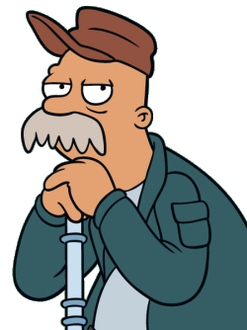
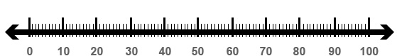
Required Information
Sensor Values are between 0 and 100
Notes:
Can Demo Jade Scratch if people are interested. In doing this product I’ve had a few interesting discoveries – one was going with a simpler programming language actually has a *LOT* of value for an expert like myself.

Slide 10
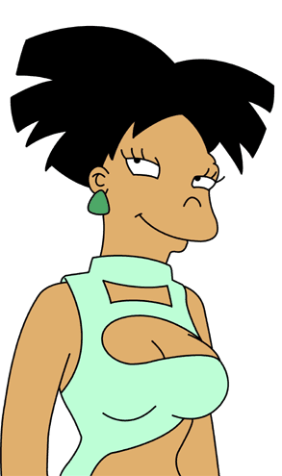
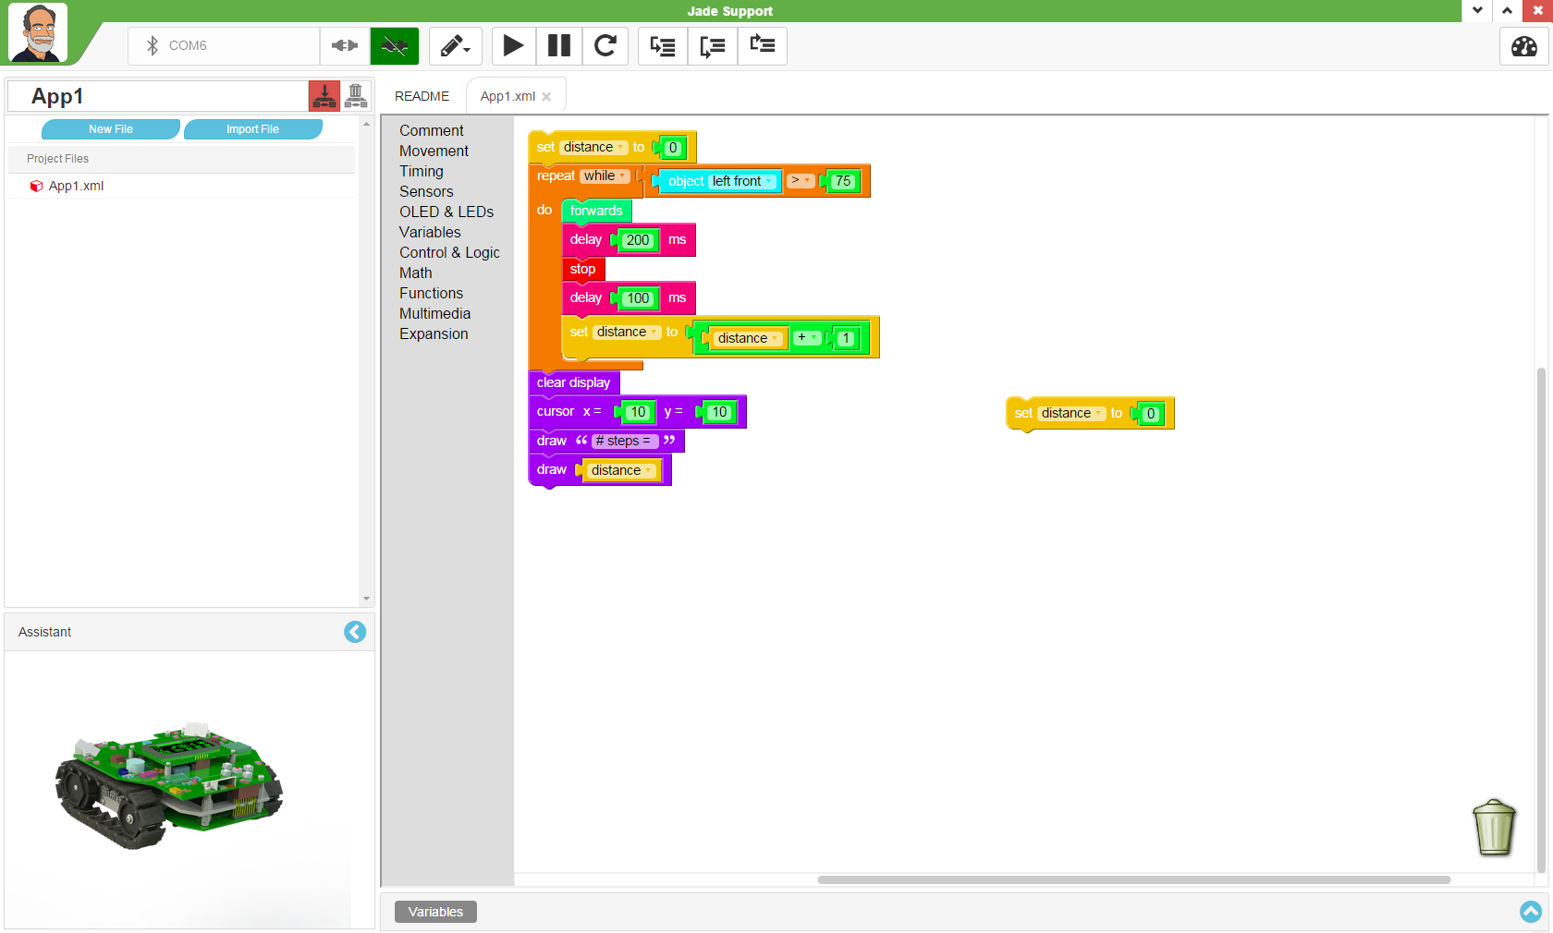
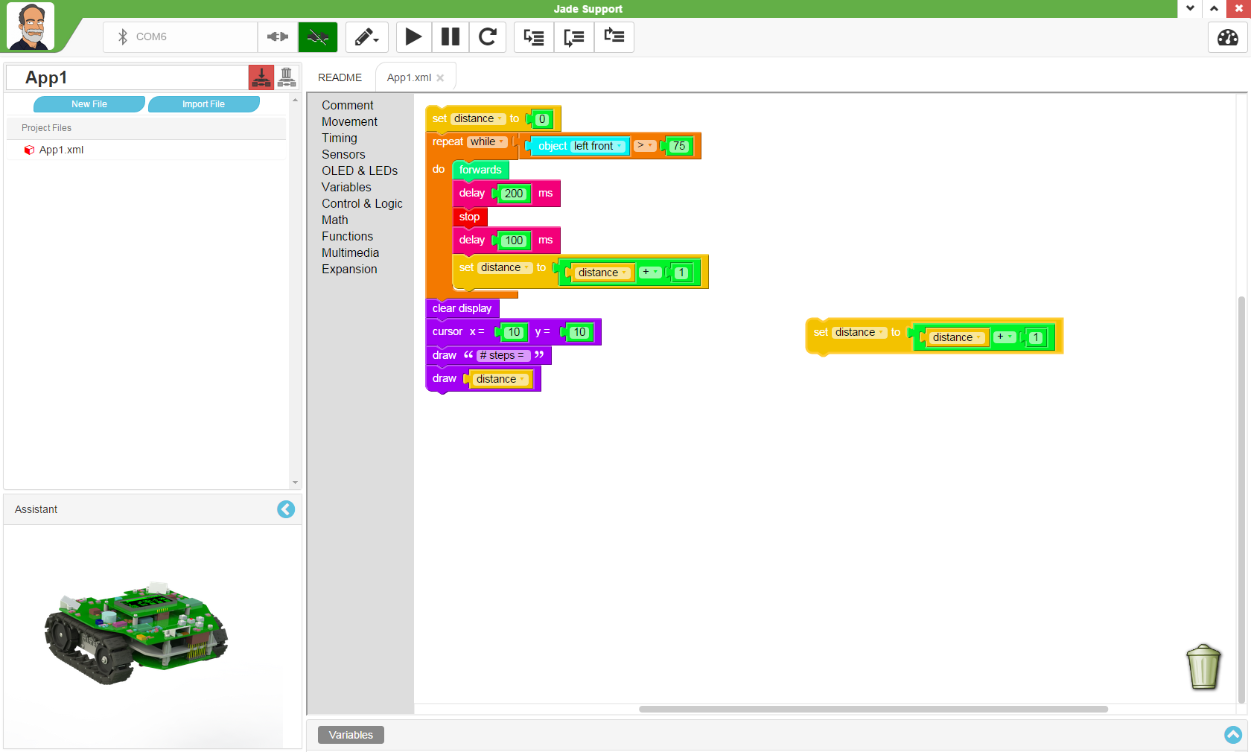
Required Information
Variables can be set to any value
AND
Can be Assigned the Result of a Mathematical Operation
Notes:
Can Demo Jade Scratch if people are interested. In doing this product I’ve had a few interesting discoveries – one was going with a simpler programming language actually has a *LOT* of value for an expert like myself.

Slide 11
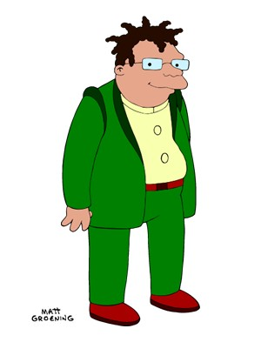
Break Into Parts
Move Forwards in Increments
Move Forwards and Count Increments Until Wall Encountered.
Back Up to Original Position
Notes:
Can Demo Jade Scratch if people are interested. In doing this product I’ve had a few interesting discoveries – one was going with a simpler programming language actually has a *LOT* of value for an expert like myself.

Slide 12

Distance & Counting
Distance = Movements * Number of Moves
Incrementing = Number + 1
Notes:
Can Demo Jade Scratch if people are interested. In doing this product I’ve had a few interesting discoveries – one was going with a simpler programming language actually has a *LOT* of value for an expert like myself.

Slide 13
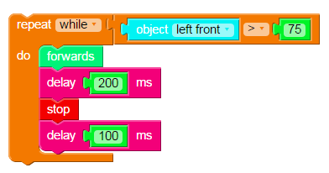
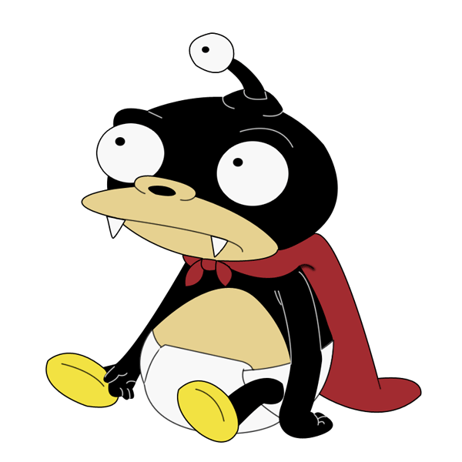
“part1”
Notes:
Can Demo Jade Scratch if people are interested. In doing this product I’ve had a few interesting discoveries – one was going with a simpler programming language actually has a *LOT* of value for an expert like myself.

Slide 14
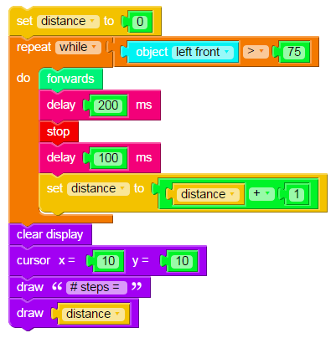
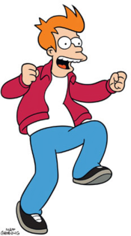
“part2”
Show How
Many Steps
Notes:
Can Demo Jade Scratch if people are interested. In doing this product I’ve had a few interesting discoveries – one was going with a simpler programming language actually has a *LOT* of value for an expert like myself.

Slide 15
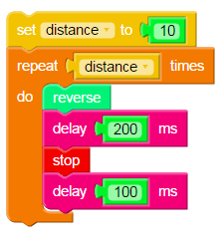
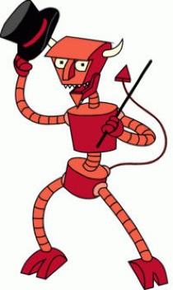
Test Value
“part3”
Notes:
Can Demo Jade Scratch if people are interested. In doing this product I’ve had a few interesting discoveries – one was going with a simpler programming language actually has a *LOT* of value for an expert like myself.

Slide 16
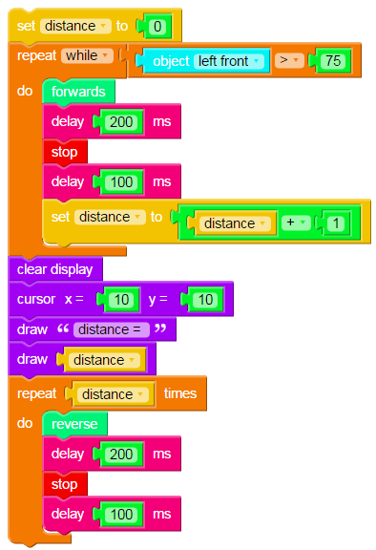
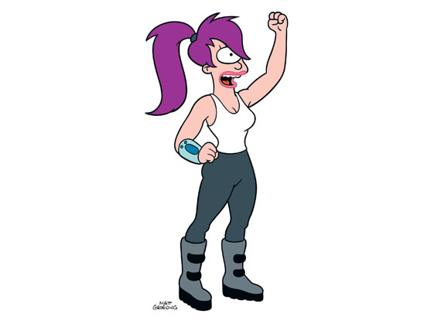
“together”
Notes:
Can Demo Jade Scratch if people are interested. In doing this product I’ve had a few interesting discoveries – one was going with a simpler programming language actually has a *LOT* of value for an expert like myself.

Slide 17
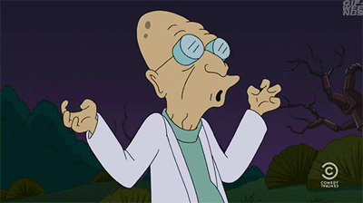
Class Challenge
Notes:
We want to introduce the Jade Robot and it’s Tools in more detail along with our action plans for it.
It’s interesting, but it’s easy to criticize something when it’s done (especially when you have experience) – a *LOT* more difficult getting it right from the start. Also, preparing this presentation was a great way to review and think about what we should be doing.

Slide 18
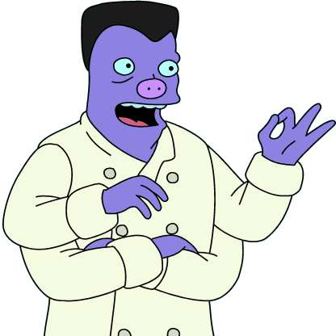
Move Forwards Until Construction Paper Encountered. Turn Right 90 degrees. Go forwards for 50 cm.
Notes:
Can Demo Jade Scratch if people are interested. In doing this product I’ve had a few interesting discoveries – one was going with a simpler programming language actually has a *LOT* of value for an expert like myself.

Slide 19
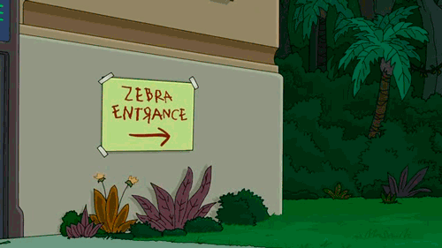
Did anybody fall into a trap?
Notes:
We want to introduce the Jade Robot and it’s Tools in more detail along with our action plans for it.
It’s interesting, but it’s easy to criticize something when it’s done (especially when you have experience) – a *LOT* more difficult getting it right from the start. Also, preparing this presentation was a great way to review and think about what we should be doing.

Slide 20
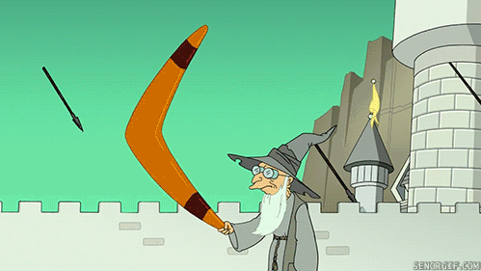
Grade 8 Systems
Class 7
Putting it All Together
Notes:
We want to introduce the Jade Robot and it’s Tools in more detail along with our action plans for it.
It’s interesting, but it’s easy to criticize something when it’s done (especially when you have experience) – a *LOT* more difficult getting it right from the start. Also, preparing this presentation was a great way to review and think about what we should be doing.

Slide 21
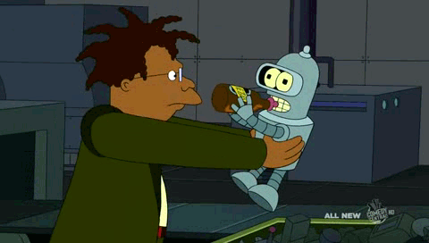
Grade 8 Systems
Class 7
Putting it All Together
Notes:
We want to introduce the Jade Robot and it’s Tools in more detail along with our action plans for it.
It’s interesting, but it’s easy to criticize something when it’s done (especially when you have experience) – a *LOT* more difficult getting it right from the start. Also, preparing this presentation was a great way to review and think about what we should be doing.

Slide 22
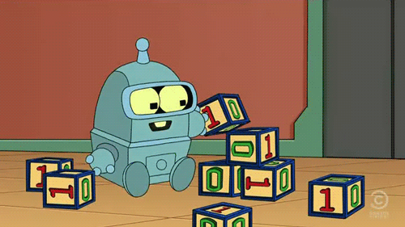
Grade 8 Systems
Class 7
Putting it All Together
Notes:
We want to introduce the Jade Robot and it’s Tools in more detail along with our action plans for it.
It’s interesting, but it’s easy to criticize something when it’s done (especially when you have experience) – a *LOT* more difficult getting it right from the start. Also, preparing this presentation was a great way to review and think about what we should be doing.

